Slide 1
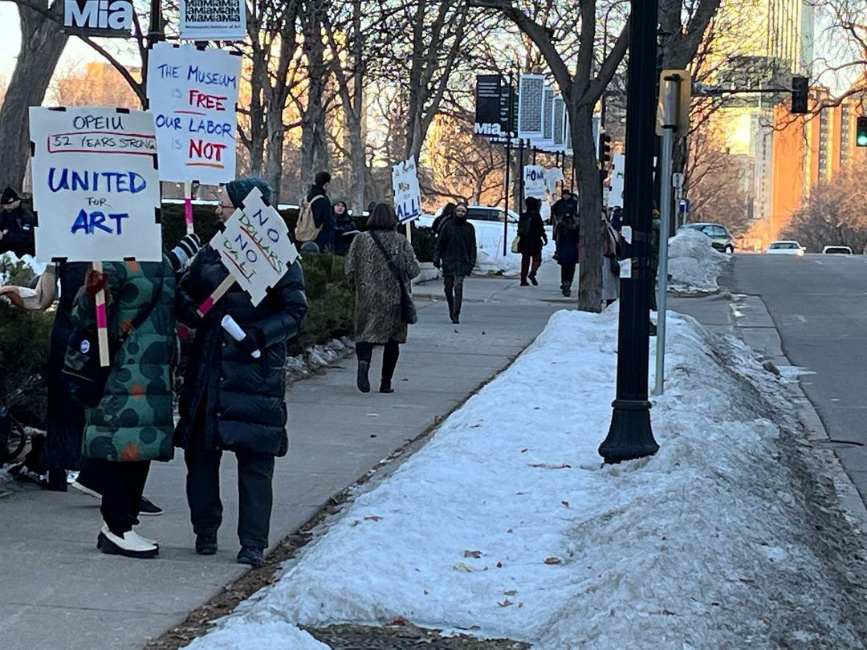
Shop Steward Fundamentals

Slide 2
Union Shop Reporting
Union Rep
Chief Steward
Shop Steward
Shop Steward
Shop Steward
Members
Members
Members

Slide 3
Fundamentals of the Chain of command
Shop Stewards are to always report to the chief stewards in your unit. The Chief steward will assist the rep with organizing grievances and tracking them and answering questions.
This helps prevent the union rep from getting overwhelmed with calls from members and stewards.
Chief Stewards are elected by their fellow stewards. This process is put in place by each individual bargaining unit.
Some units are too small, to which a chief is not necessary. This pertains to shops with several stewards and employees.
The employees are encouraged to always go to their department or unit steward first before contacting a rep or chief steward.

Slide 4
The Laws That Govern
National Labor Relations Act (NLRA) Federal Labor Law that covers most private sector workers in the US.
Public Employee Labor Relations Act (PELRA) is the law that covers public sector workers like school employees.
State Labor Law
Collective Bargaining Agreement (CBA)
Company Policies
Past Practice

Slide 5
Rights as a Steward
To be treated as an equal to management when you are in role as a steward.
This right does not apply when you are not performing steward duties.

Slide 6
Legal Rights
No retaliation or discrimination because you are a steward.
For example, stewards and other union representatives cannot be punished or discriminated against because of their union activity, for filing grievances, conducting union business at the appropriate time described in the contract, or raising workplace issues with members of management. They cannot be punished for serving on a bargaining committee or distributing union literature at the appropriate time.
All union members and stewards have a right to perform Concerted Activities. Concerted activated are activities a union member or steward would perform for the purpose of collective bargaining or other mutual aid or protection.

Slide 7
Right to Information
Under the National Labor Relations Act (NLRA), unions have the right to request and receive information from the employer that is relevant to processing grievances and negotiating contracts.
The employer, as part of its legal duty to bargain in good faith, is obligated to provide information to the union upon request.
This goes for Public Sector Employees too.

Slide 8
Information you can request
company memos
performance reviews
contracts
personnel files
correspondence
photographs
disciplinary records
equipment specifications
accident records
job descriptions
attendance records
material records
bargaining notes
payroll records
Surveillance Video
reports and studies

Slide 9
Your Right to Representation-Weingarten
Every employee has the right to union representation during an investigatory meeting.
The supervisor does not have to inform you of this right.
A representative must be requested by the employee.

Slide 10
Your Right to Representation-Weingarten
Applies to investigatory meetings.
An investigatory meeting is one in which a supervisor questions an employee to obtain information that could be used as the basis for discipline or asks an employee to defend their conduct.
If an employee has a reasonable belief that discipline or discharge may result from what they say, the employee has the right to request Union representation.

Slide 11
Weingarten Rules
The employee must make a clear request for Union representation before or during the interview. The employee can't be punished for making this request.
After the employee makes the request, the supervisor has 3 options. They must either:
Grant the request and delay the interview until the Union representative arrives and has a chance to consult privately with the employee: or
Deny the request and end the interview immediately; or
Give the employee a Choice of 1)having the interview without representation or 2) ending the interview
If the supervisor denies the request and continues to ask questions, this is an unfair labor practice, and the employee has a right to refuse to answer. The employee cannot be disciplined for such refusal but is required to sit there until the supervisor terminates the interview. Leaving before this happens may constitute punishable insubordination.

Slide 12
Union Representative’s Rights Under Weingarten
You are not required to merely be 'silent witness’, You have the right to:
Be informed by the supervisor of the subject matter of the interview.
Take the employee aside for a private conference before questioning begins.
Speak during the interview.
Request that the supervisor clarify a question so that what is being asked is understood.
Give the employee advice on how to answer a question.
Provide additional information to the supervisor at the end of the questioning.

Slide 13
You do not have the right to tell the employee not to answer nor, obviously, to give false answers. An employee can be disciplined for refusing to answer questions.
A standard statement to suggest to members is:
"If this discussion could in any way lead to my being disciplined or discharged, I request that my Union representative be present at the meeting. Without representation, I choose not to answer any questions."

Slide 14
An employee has NO right to the presence of a Union representative if:
The meeting is merely for the purpose of conveying work instructions, training, or communicating needed corrections in the employee's work techniques.
The employee is assured by the employer prior to the interview that no discipline or employment consequences can result from the interview.
The employer has reached a final decision to impose certain discipline on the employee prior to the interview, and the purpose of the interview is to inform the employee of the discipline or to impose it.
Any conversation or discussion about the previously determined discipline which is initiated by the employee and without employer encouragement or instigation after the employee is informed of the action

Slide 15
Duty of Fair Representation
The union must fairly represent all employees in the unit, both members and non-members.
Treat all members of the bargaining unit the same. It is unlawful to refuse to process a grievance or provide representation to a person who is not a member of the union.
Non-discrimination. The union cannot discriminate against its members because of their race, gender, age, or ethnic background.

Slide 16
Types of grievances stewards will encounter
Discipline
Policy or Rule
Past practice

Slide 17
Discipline
Verbal, written warnings, suspensions, terminations.
Burden of proof lies with management.
Under most contracts employees can only be disciplined for ”Just Cause”
Was progressive discipline applied? Verbal, written, final written, suspension, termination.
Certain infractions or “cardinal sins” can bypass progressive discipline.

Slide 18
Just Cause
Only if you can answer most of these questions affirmatively, has the employer met its obligation to act for cause:
Was a rule or order established?
Was the rule or order reasonable?
Was there adequate notice to the employee about the rule or order?
Was there an investigation? Was it proper?
Was there equal treatment?
Did the investigation produce sufficient evidence or proof?
Did the penalty fit the offense or was it too harsh?

Slide 19
How do you investigate?
Interview members, witnesses, management
Get members together to compare notes
Check the contract, policies, past practice
Get documents: memos, schedules, etc.

Slide 20
Your investigation is the foundation for everything that happens with this case.
Get the facts of a case (especially discipline) while people’s memories are fresh and before stories change.
Don’t form judgments about the case until you have completed your investigation.
Don’t argue the case when you should be investigating.
Has this been grieved before? How did it turn out?
How many people does it affect?
Where else is this happening?
Is there someone in the union who has knowledge or experience handling this kind of situation or with the contract sections involved?

Slide 21
Interviewing Members
Find the best place to talk (private, quiet, etc.).
Put member at ease.
Explain that you may ask some challenging questions to prepare for what management will say.
Ask the member what happened-5 W’s + R.
Listen and take notes, try not to interrupt.

Slide 22
Don’t make any promises about the outcome of the case.
If you don’t know the answer to a question don’t guess, say you will find out and get back to the member.
Don’t take the responsibility to “fix” the problem yourself. Explain next steps and when you will get back with the member.

Slide 23
The 5 W’s + R
Who? Who is involved? This might include the member’s full name, Phone #, department, job classification, pay rate, shift and seniority date(s) or other information for all involved.
When? When did it occur? Try to identify the specific date, time or shift an incident took place. Or you might want to establish a chronology of events.
Where? Where did it occur? The exact location where the incident occurred, on or off employer premises.
Why? Why is this a grievance? Contract language, work rules, policies or procedures, or laws that were violated.
Witnesses? Were there any witnesses? Reach out to the individuals who may have seen or heard what took place.
Remedy? What kind of settlement do we want? What does the grievant want? What is needed to restore the worker to the same position if the injustice had not occurred? For example, if an employee was discharged, the demands for settlement may be reinstatement with back pay and benefits.

Slide 24
Policy or Rule grievance
a dispute over the language and/or interpretation of language in the contract.
Burden of proof lies with the union.
Management does have the right to make changes, provided the changes are not covered in the CBA
The union has the right to bargain over the effects of the change.

Slide 25
Past Practice: Often misused-Past practice refers to policies, procedures, benefits or practices that:
Occur on a regular basis over time.
Apply consistently to the entire group affected by the practice.
Both the union and management have accepted and/or not challenged.
Do not violate or contradict the contract or any written rule.
A past practice is, An implied benefit that members enjoy.
The contract is either silent on the issue or unclear about the issue.

Slide 26
Information Requests
You are entitled to any information that is relevant to your investigation. (we decide what is relevant, not management)
Ask for any relevant paperwork if the member has it (letters, memos, schedules) or discuss how to get them.
Get written permission to look in the member’s personnel file. (There may be contract language, otherwise you must make a written request)

Slide 27
Information to help decide next steps
Is this a continuing problem or one-time occurrence?
What is the source of the problem?
Who has the power and authority to resolve?
What opportunities does this grievance give you to educate the members and build the union?
Besides a grievance, how else can we resolve this problem?

Slide 28
Meeting with Management
If we speak too aggressively, we run the risk of getting a response to our tone and not our message
If we speak too passively others may not know what we want or feel they don’t have to take it seriously

Slide 29
Three parts of Assertive Statements
A simple, specific, factual statement of the issue:
On May 1 you assigned overtime to John Doe while Jane Roe has more seniority
How you feel about the issue and why:
This is a violation of our contract and we take it seriously
Specifically, what you want:
Pay Jane Roe as if she worked the overtime
and your agreement not to avoid seniority in the future

Slide 30
Don’ts:
Don’t talk to management alone. It drives a wedge between you and the member(s)
Don’t talk too much -- listen!
Don’t lose your temper
Don’t let management run the meeting
Don’t get sidetracked, intimidated
or defensive
Don’t disagree among yourselves
in front of management.

Slide 31
Sample language for grievance presentations
Openings:
“We are here to discuss the discipline you took against our member. Since the burden of proof is yours, we want to hear why you took this action and how you met the tests of just cause”
“We filed a grievance over your action which violates our contract. We will now outline the facts as we see them, which parts of the contract were violated and what we want as a remedy”

Slide 32
Call for a caucus
If your strategy hits a snag
To question grievant(s)
Consider a settlement offer
Sample language to call a caucus:
“Excuse me, we would like to take a break to discuss some things, we need about ten minutes.”
“Let us take a caucus to consider your proposal.”
“The way you are talking to us is not acceptable. We will take a caucus to give you some time to compose yourself. Call us when you are ready to continue the meeting in a respectful way.”

Slide 33
Sample language to conclude the meeting:
Since we cannot settle this here, we will be sending this grievance to the next step
We will consider your proposed settlement and get back to you by the end of the day tomorrow
To summarize, you will consider our proposal and get back to us by the end of the day tomorrow
We are not happy with your unwillingness to resolve this case. We will be reporting to our members and taking appropriate action

Slide 34
After the hearing:
Review management’s answer with the grievant(s)
Review what you learned about management’s position that will help you determine next steps
If settled, publicize and celebrate a victory, (but don’t gloat)
Follow up within the specified time limits
Get management’s commitments in writing
Keep the members informed and involved

